Slide 1
UCSD Embedded C Assignment 4
By
Hsuankai Chang
hsuankac@umich.edu

Slide 2
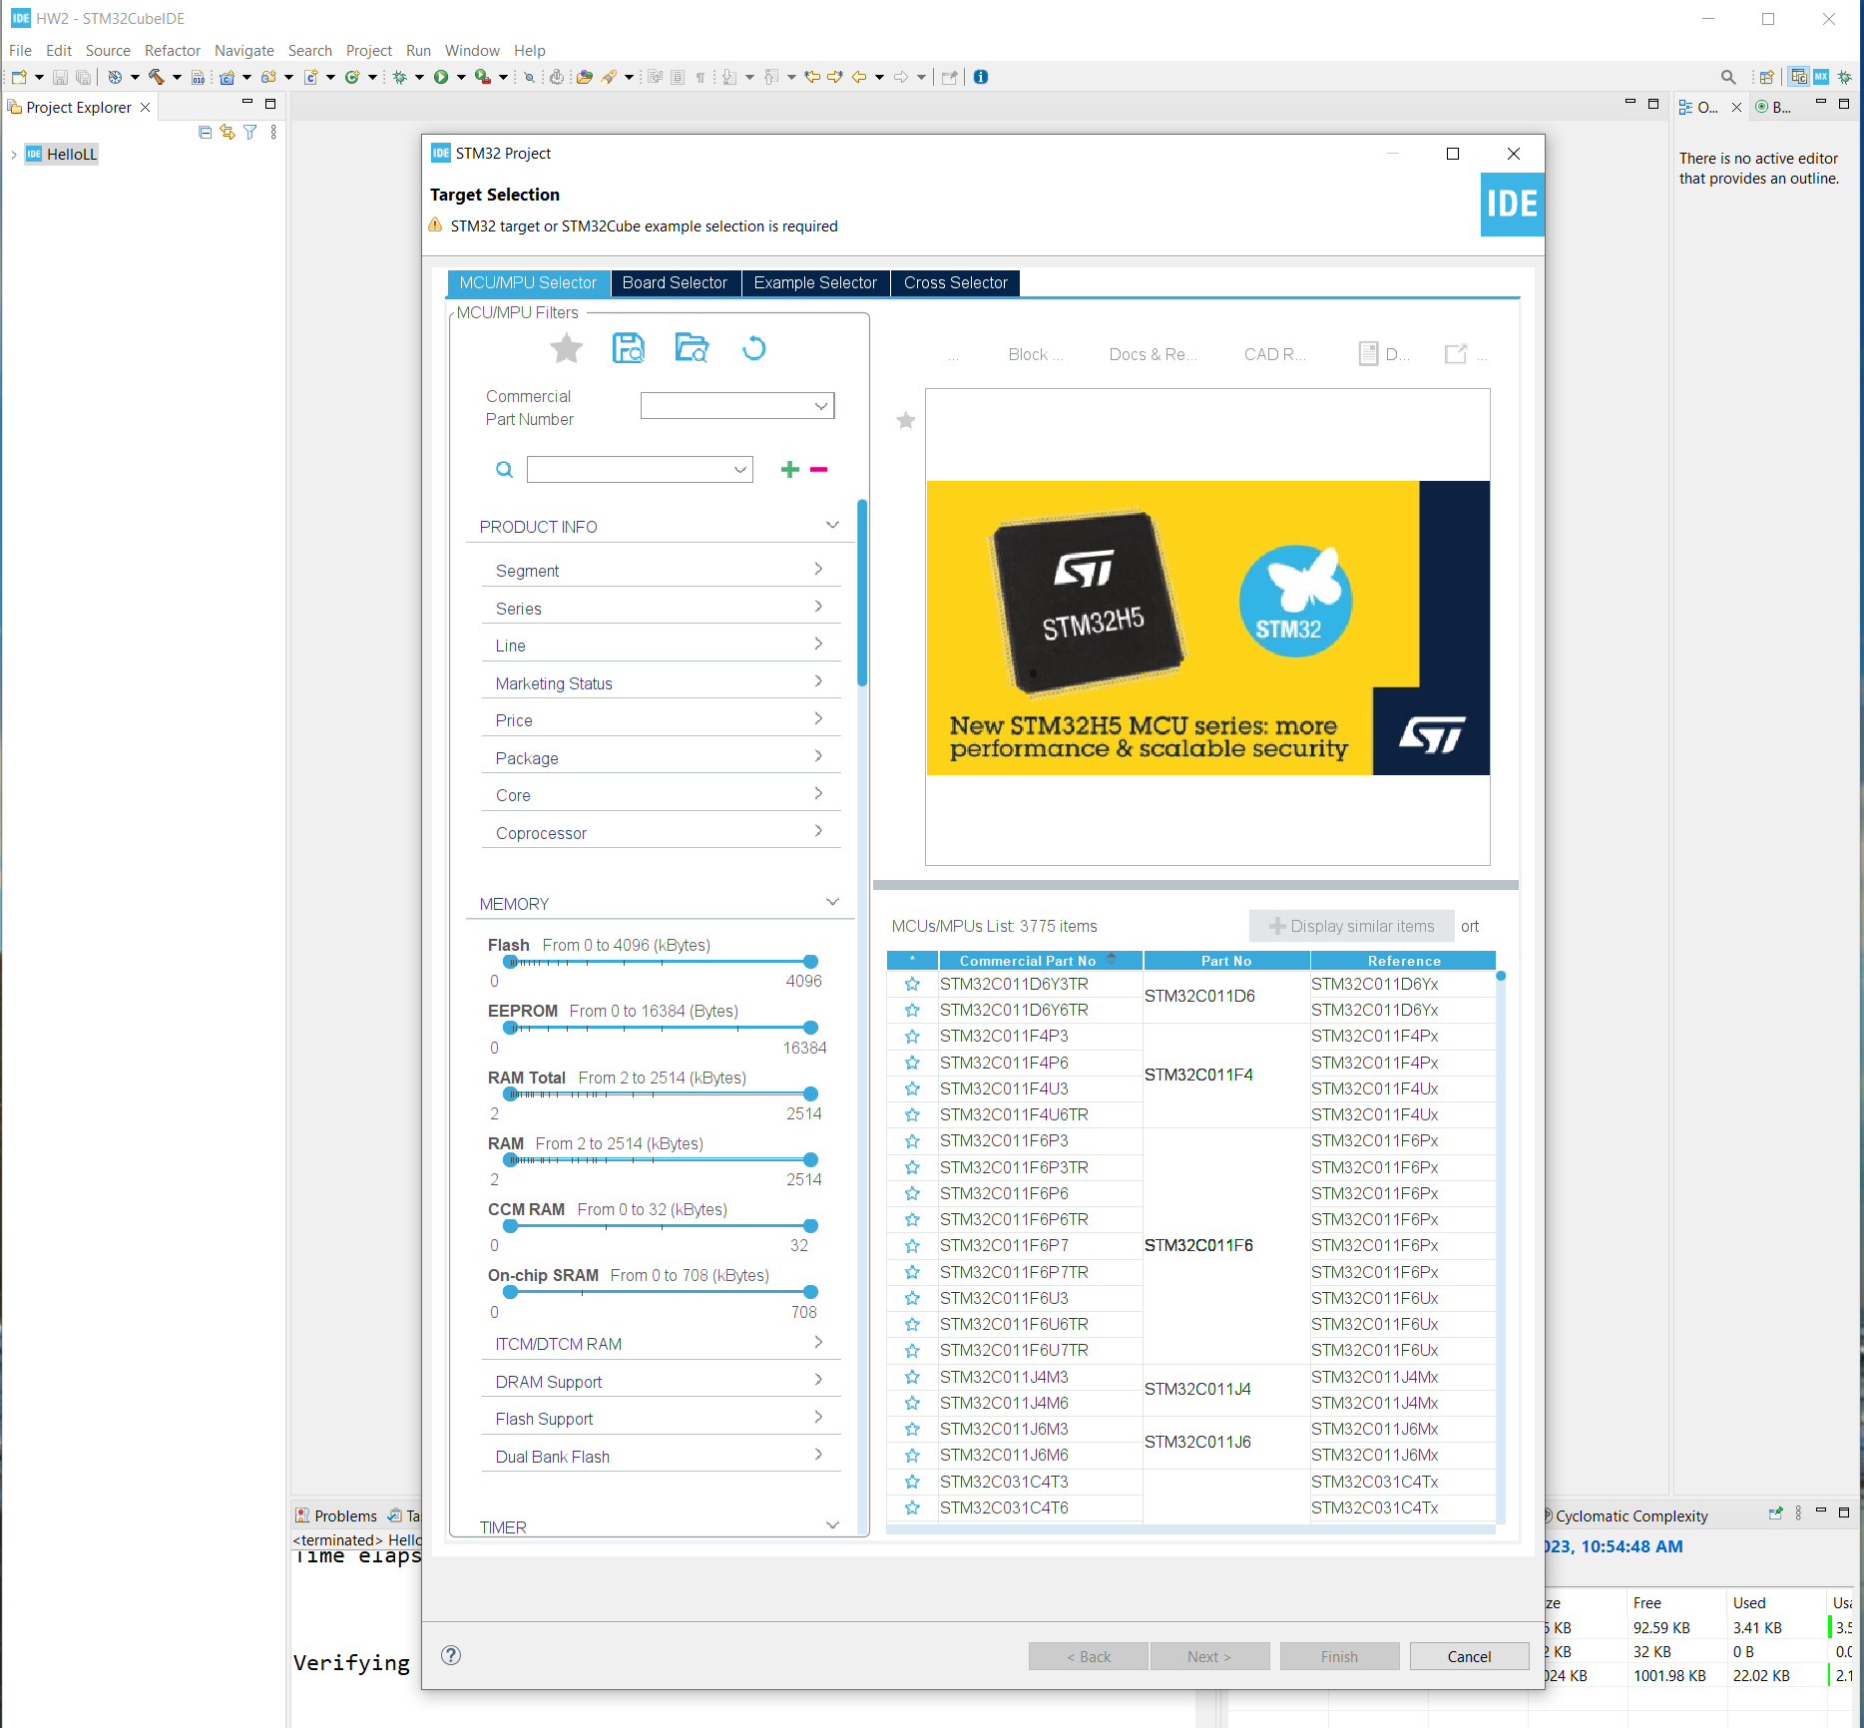
Step 1. Startup STM32CubeIDE and create new STM32 project

Slide 3
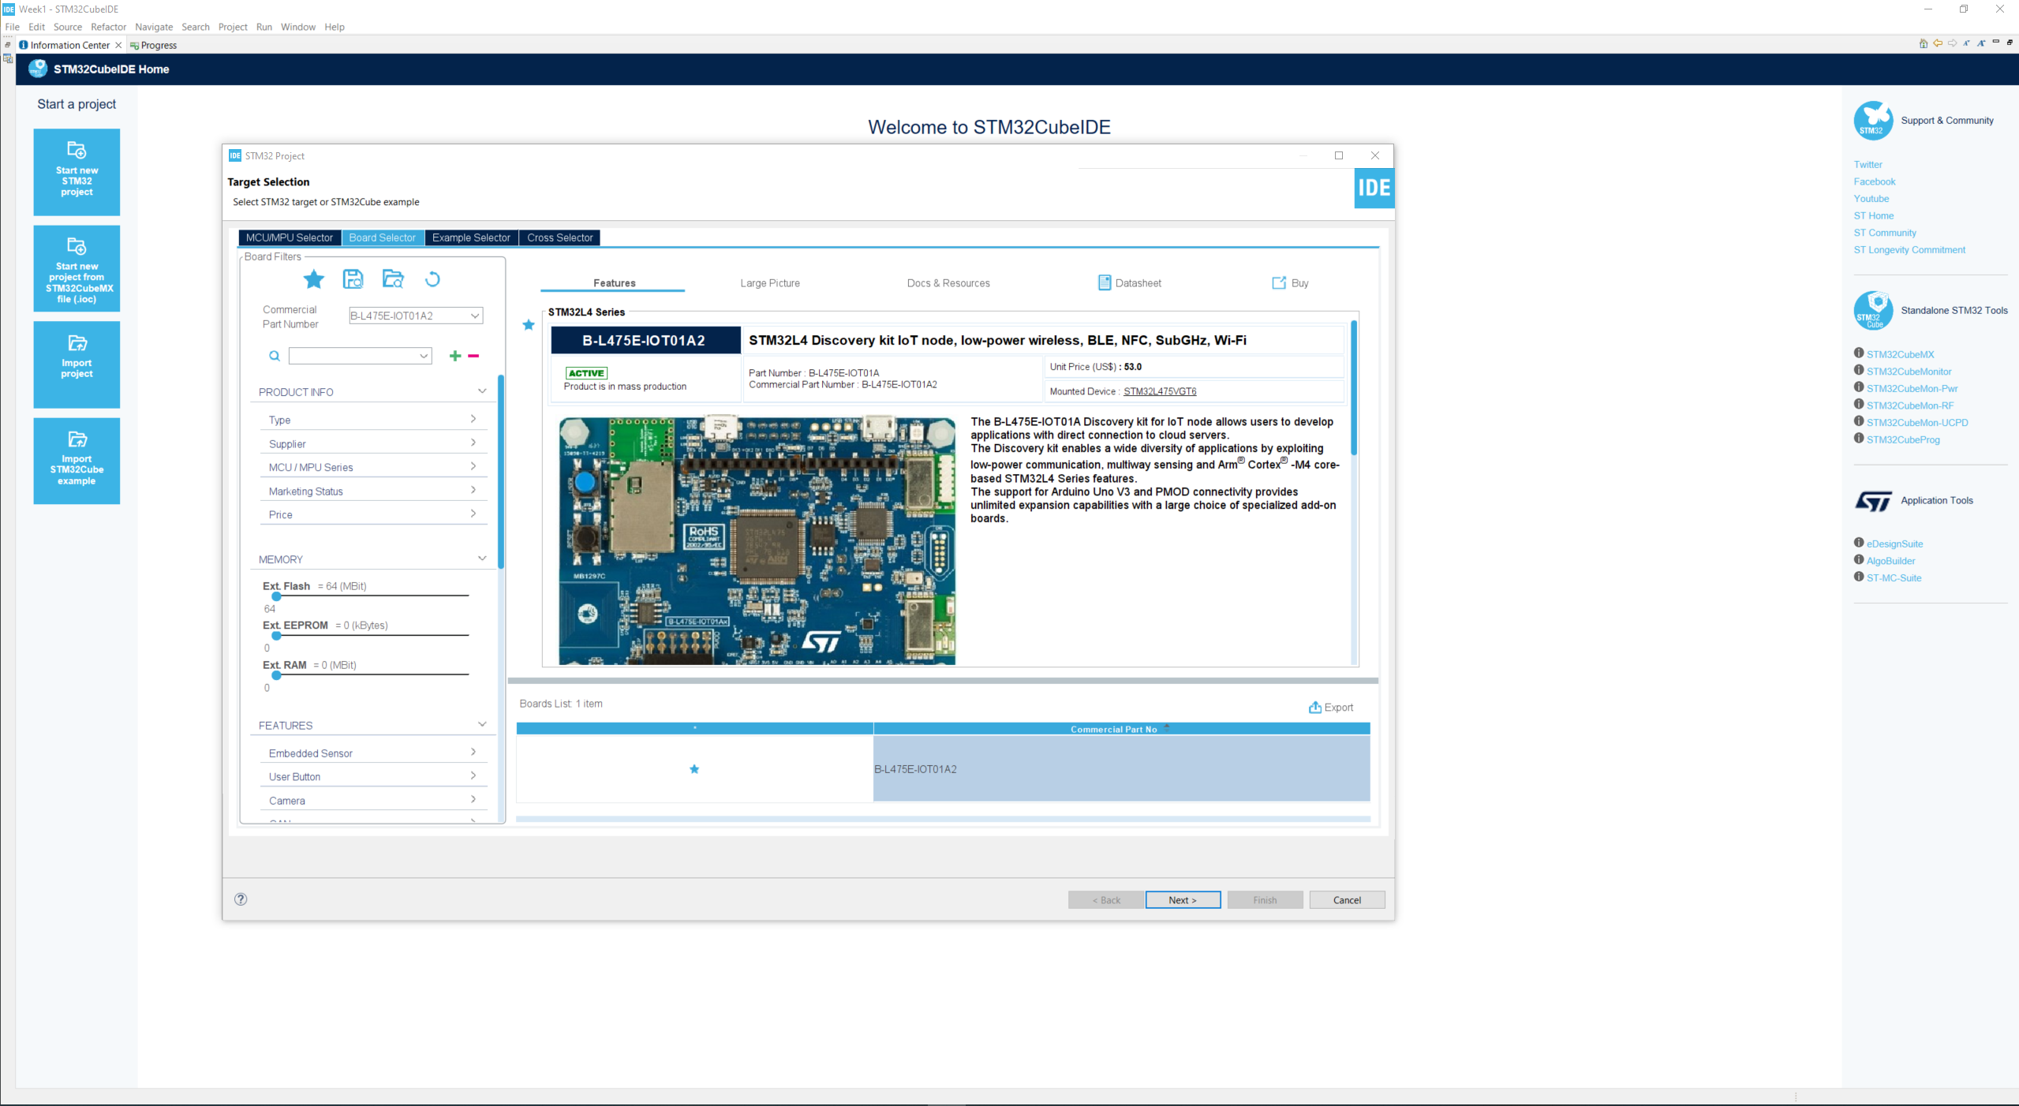
Step 2. Access board selector and type in the board you use, click Next

Slide 4
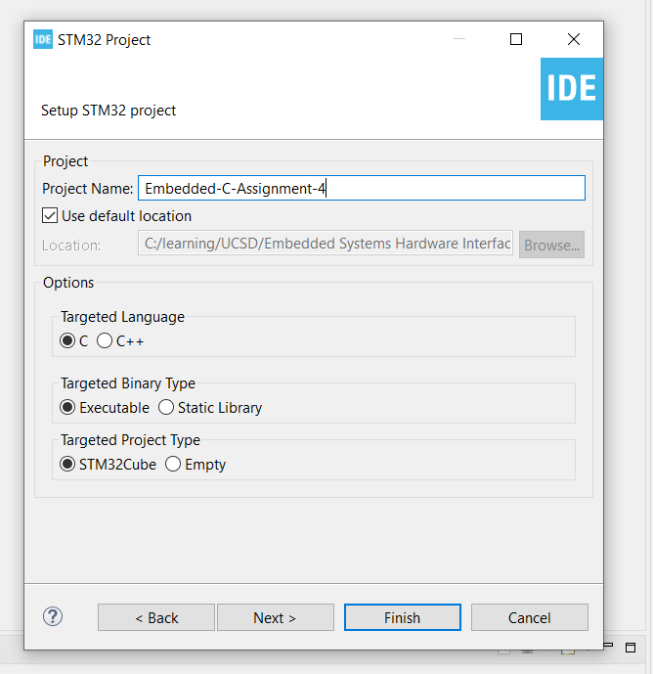
Step 3. Enter the project name then click Next

Slide 5
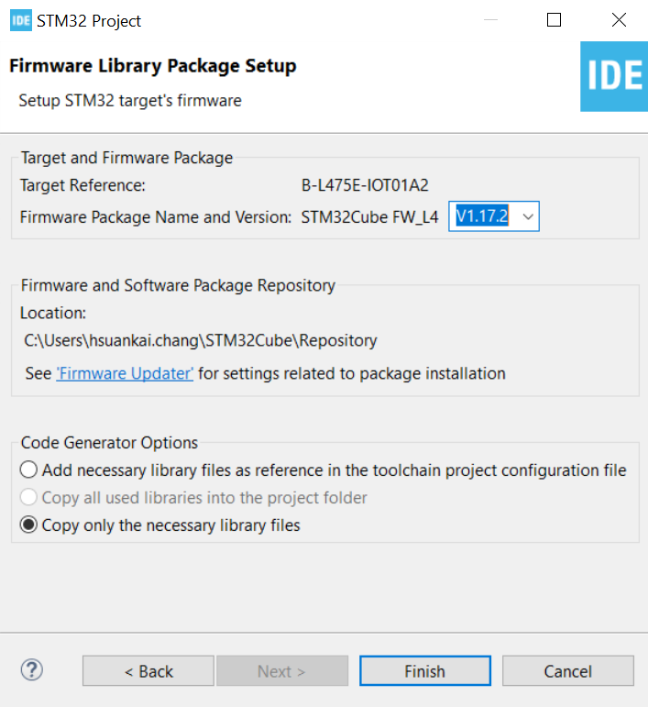
Step 4. See the firmware package name and version

Slide 6
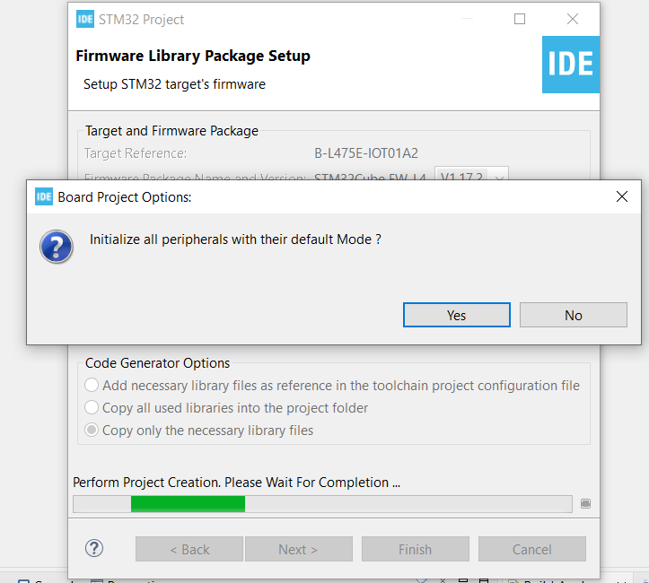
Step 5. Click yes to initialize all peripherals to default

Slide 7
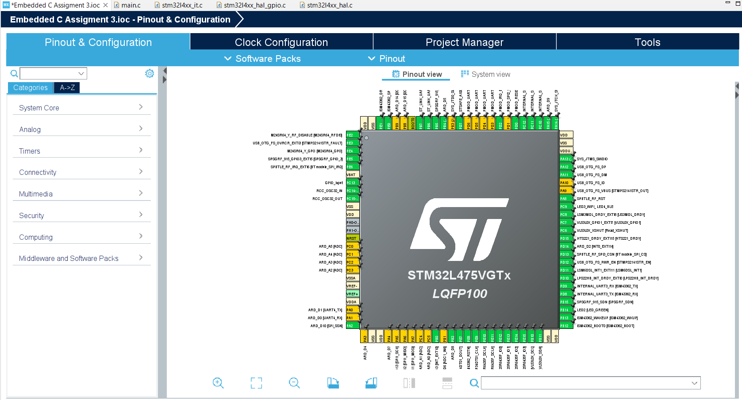
Step 6. When in .ioc file, click Pinout & Configurations

Slide 8
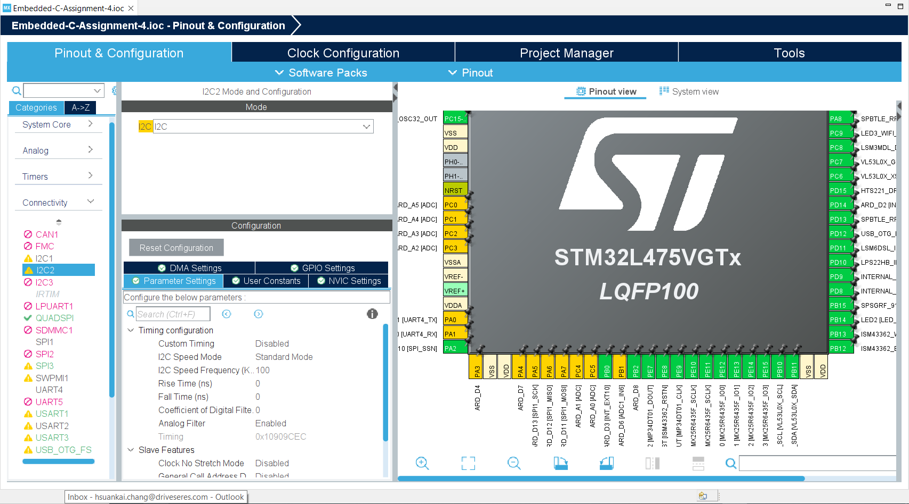
Step 7. Keep the default I2C settings

Slide 9
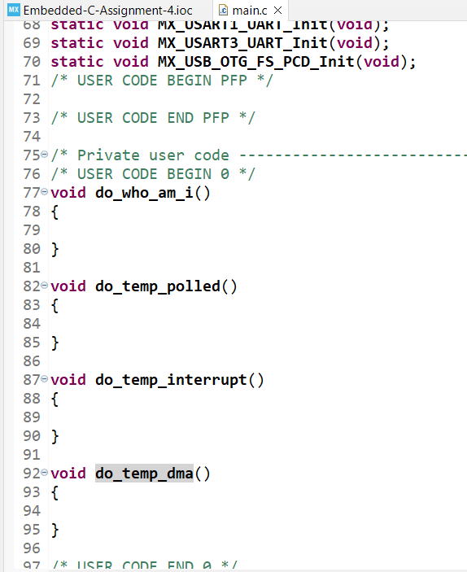
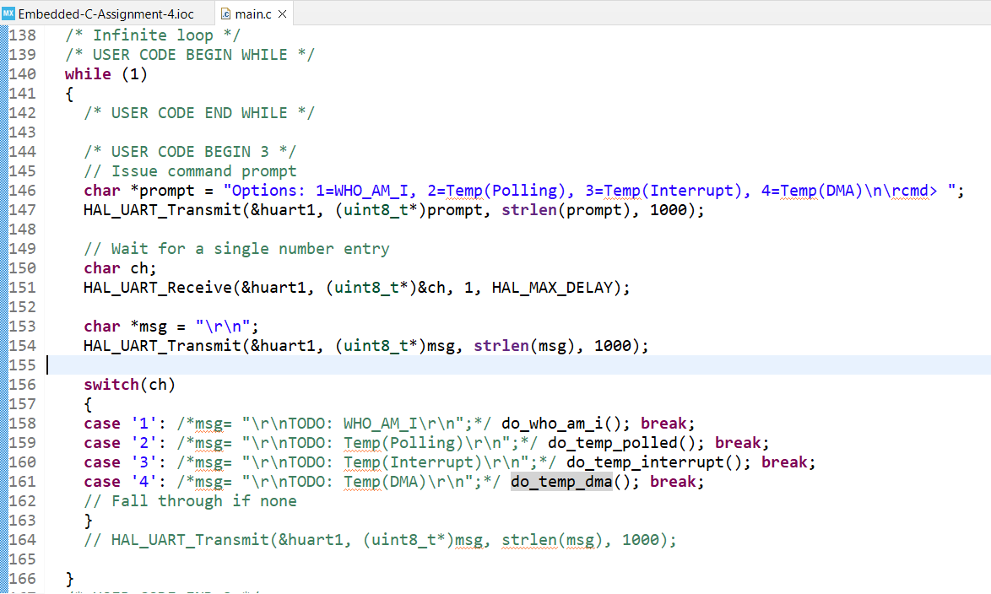
Step 8. User Story 1. CLI. Create a CLI (Command Line Interface) on UART1 that prompts you to enter a 1 for WHO_AM_I using polling, 2 temperature read using polling, and 3 for temperature readings using interrupts, and a 4 for temperature read using DMA>

Slide 10
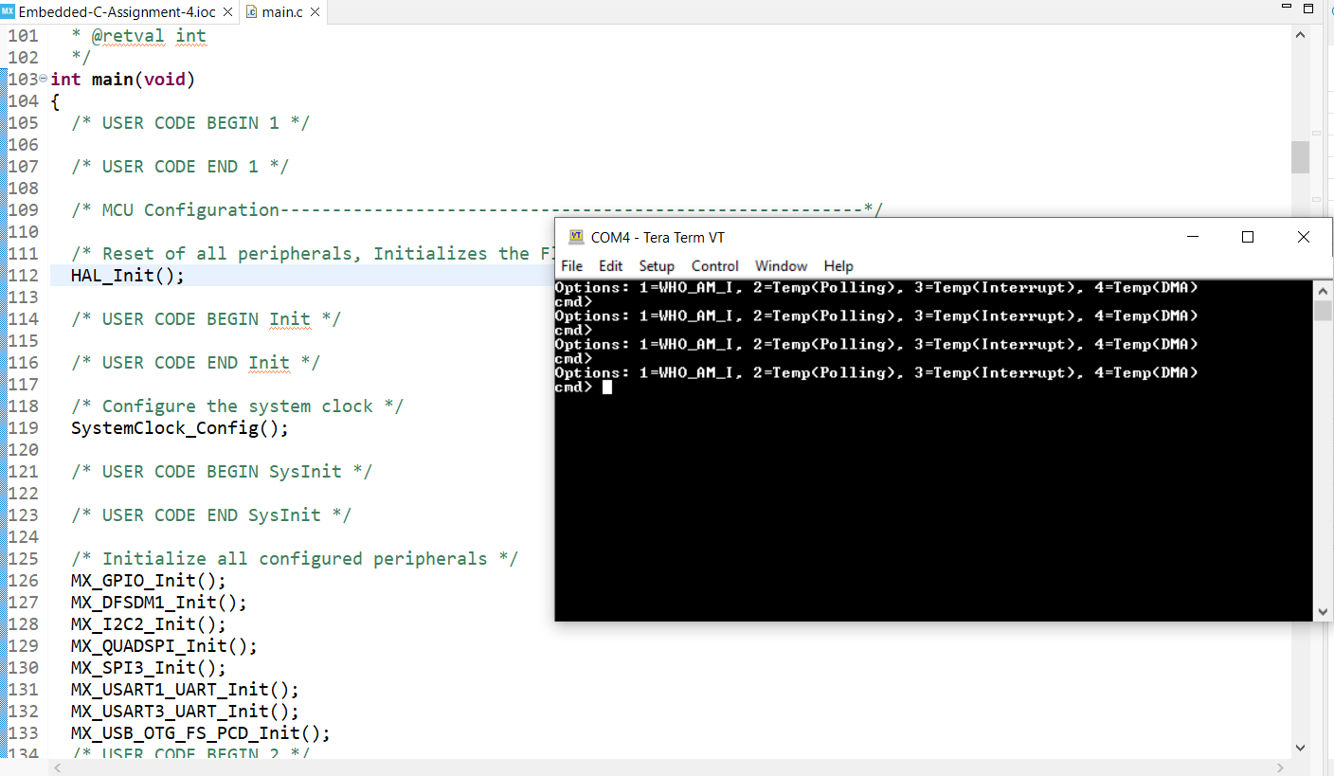
Step 9. User Story 1: Build and run in debug mode. Open tera term and test is successful

Slide 11
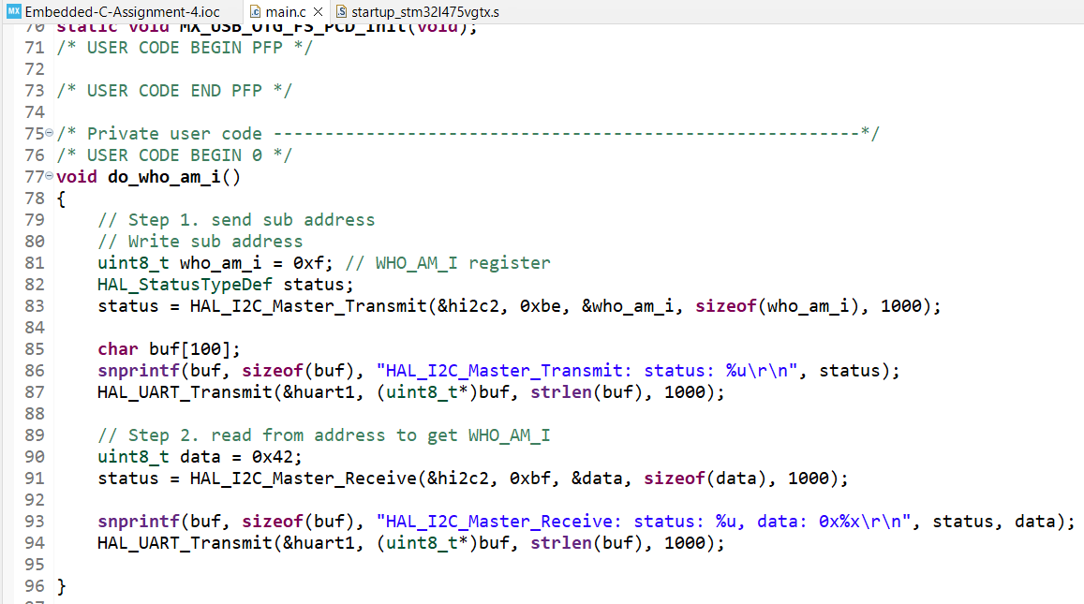
Step 10. User Story 2. WHO_AM_I. Polling. When the user selects 1, display contents of WHO_AM_I register from HTS221

Slide 12
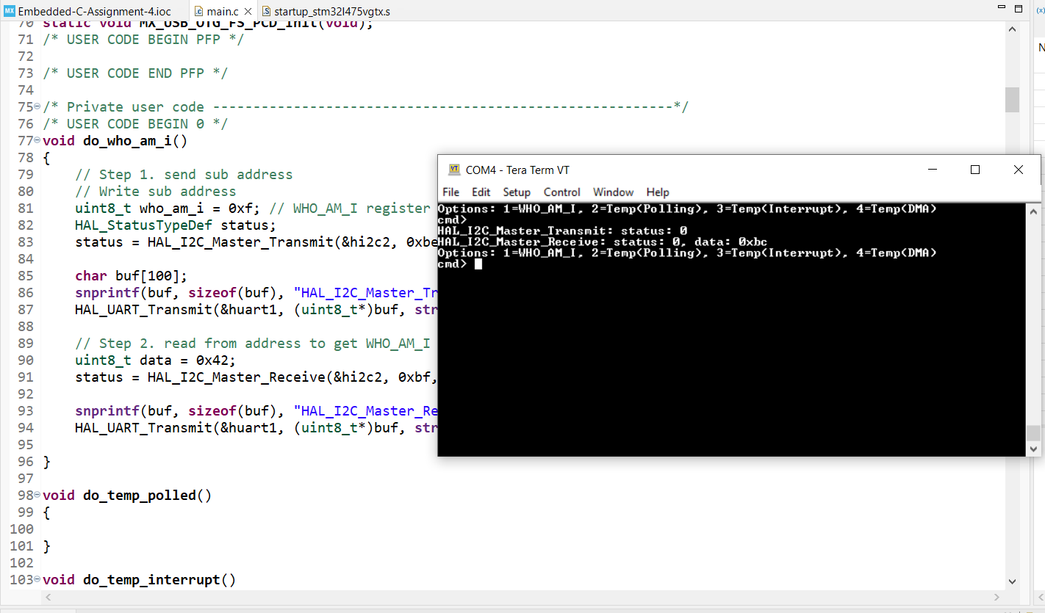
Step 11. User Story 2: Build and run the code, test is successful

Slide 13
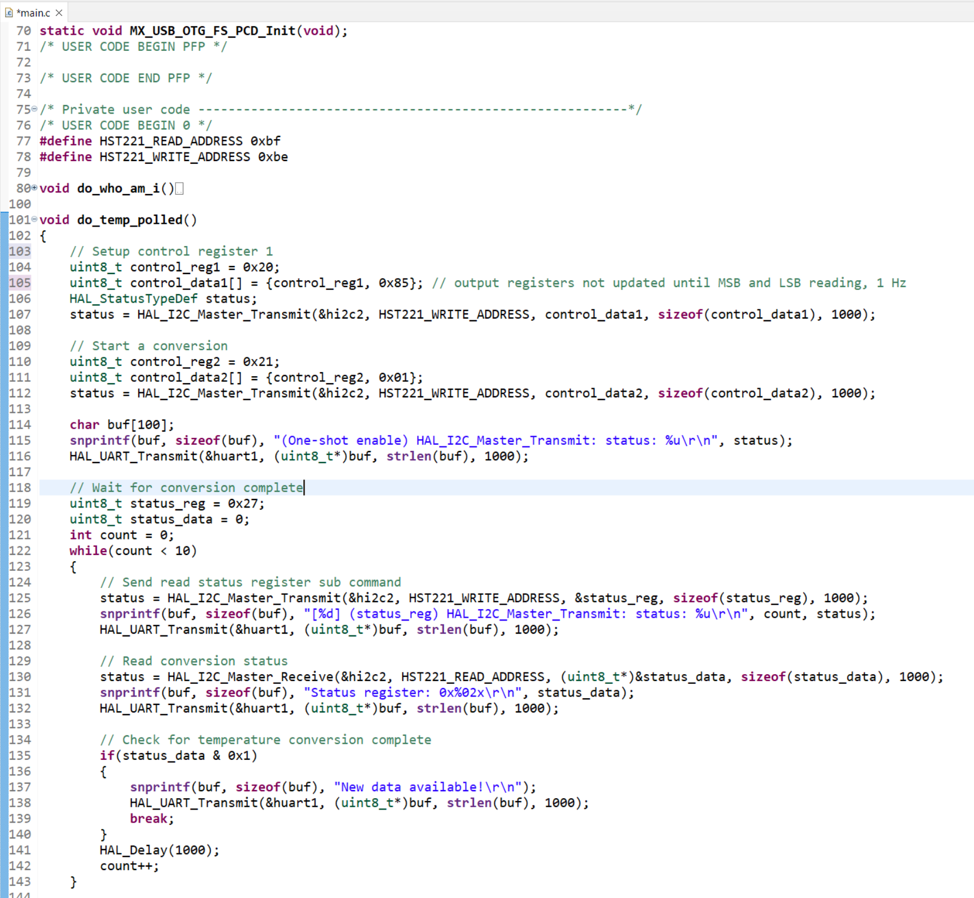
Step 12. User Story 3. Temperature. Polling. The user selects 2, use polling to read HTS221 and display temperature on console.

Slide 14
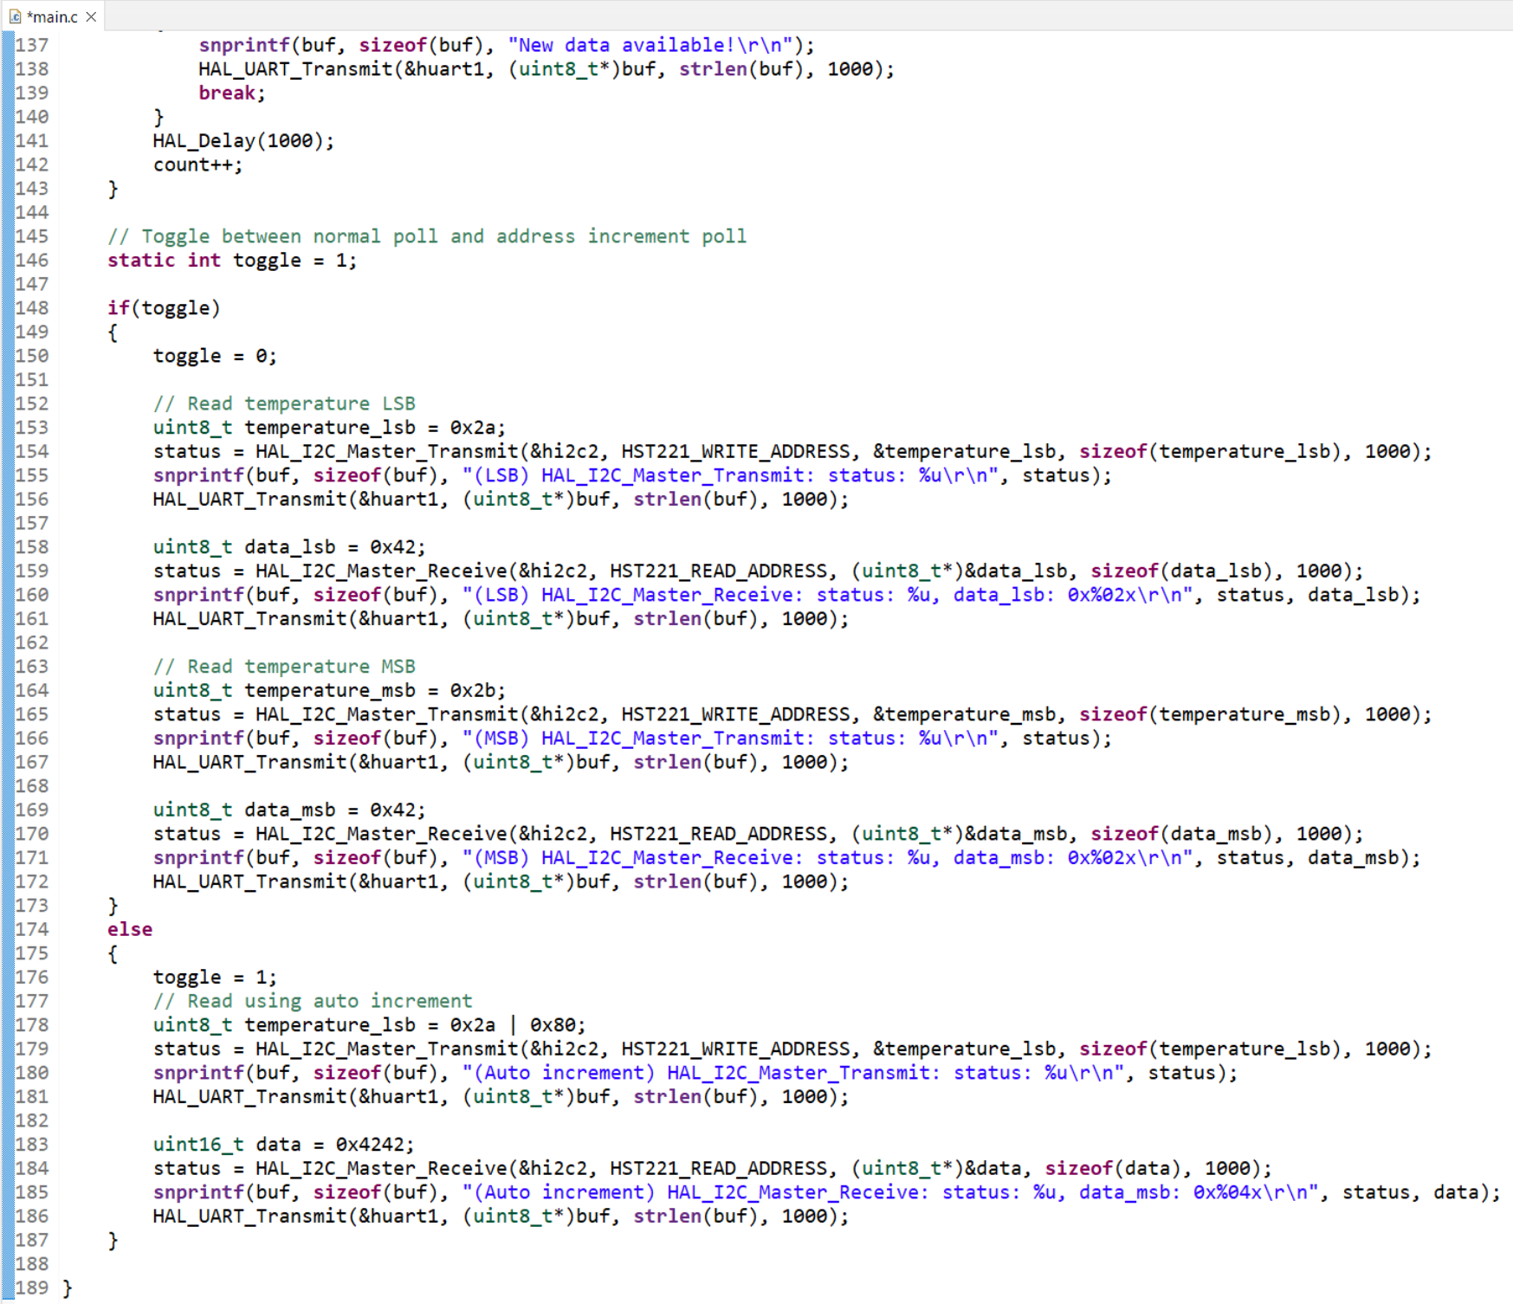
Step 13. User Story 3: Toggle between auto increment and direct read from LSB and MSB

Slide 15
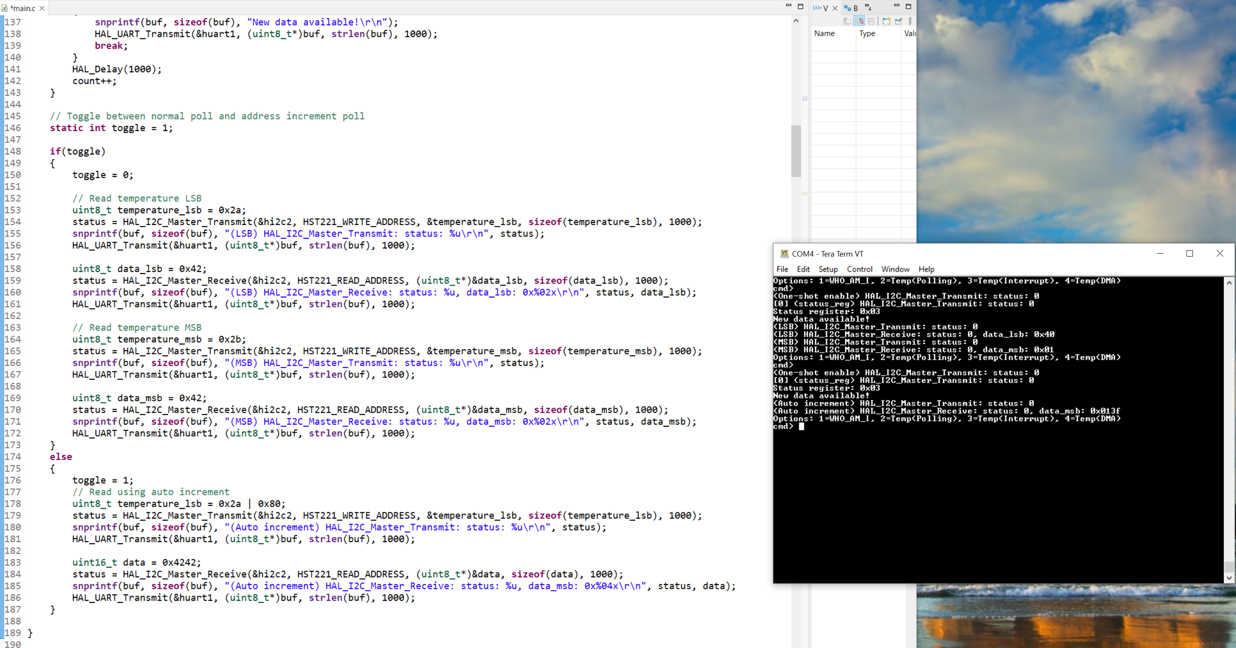
Step 14. User Story 3: Build and run the code, test is successful

Slide 16
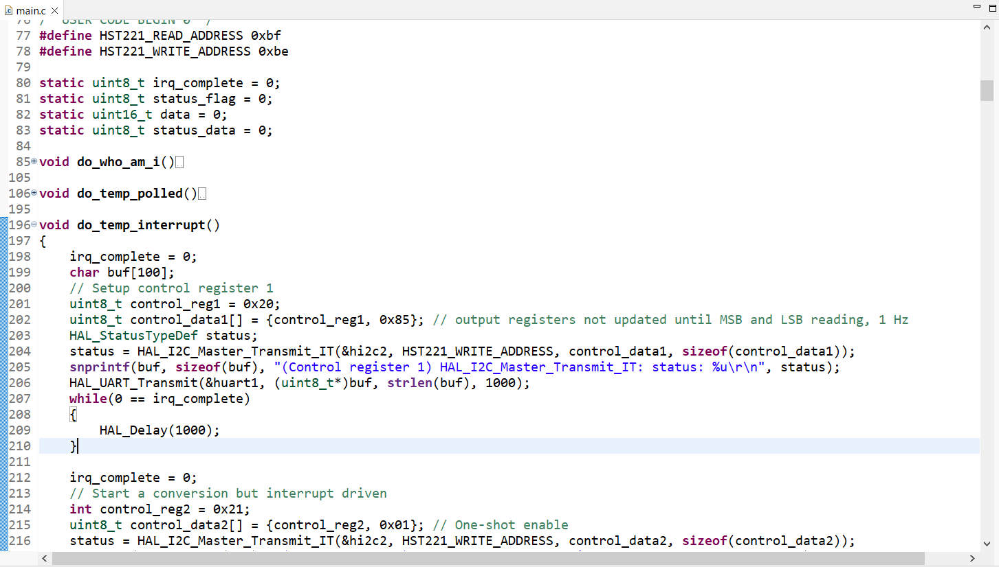
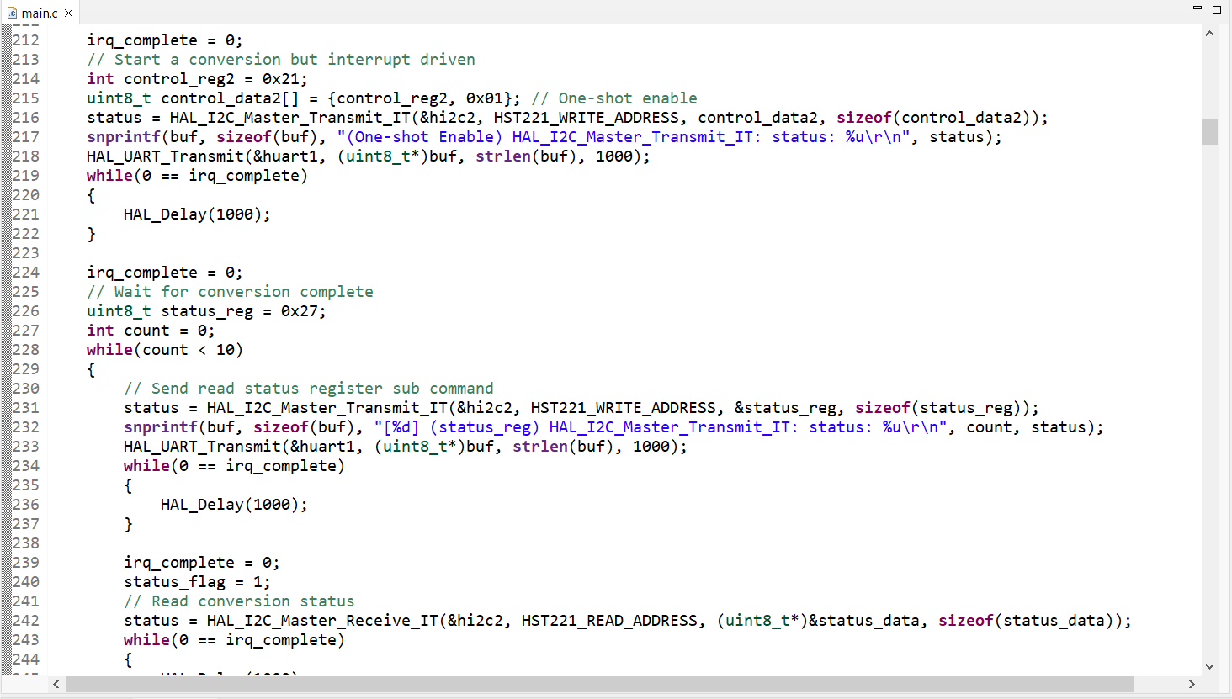
Step 15. User Story 4. Temperature. Interrupts. When the user selects 3, use interrupts to read from HTS221 and display temperature on console.

Slide 17
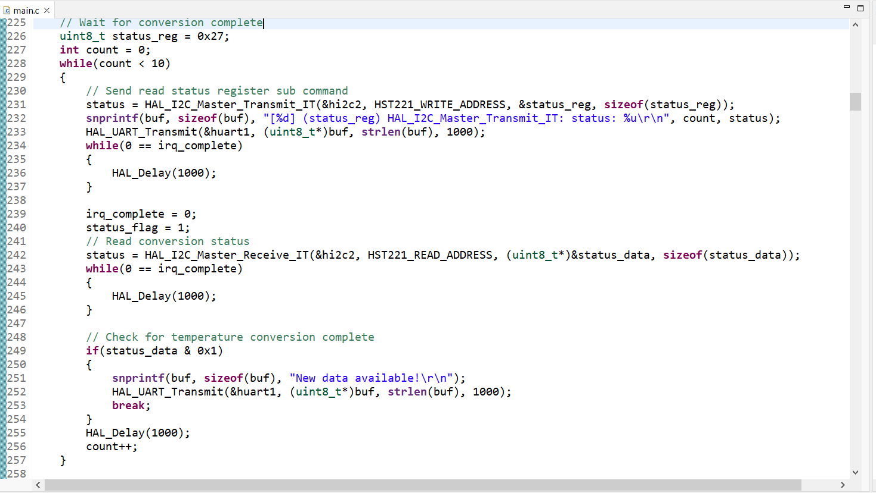
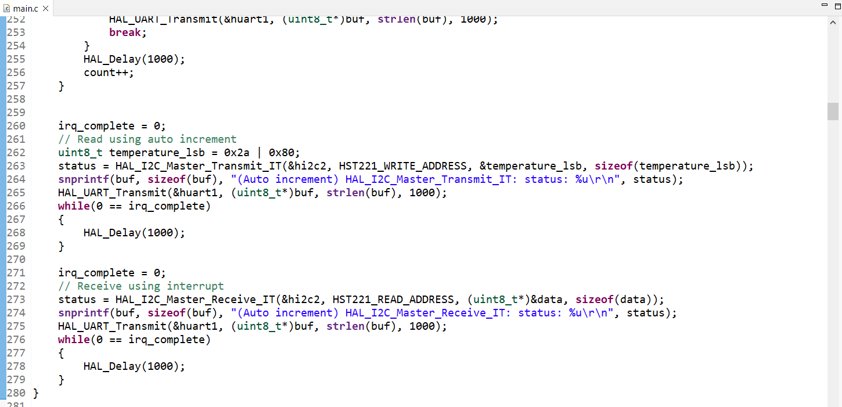
Step 16. User Story 4: I code in the way that when we use Rx or Tx interrupt mode, we check if the irq is complete or not. If it is complete, we can run to the next line of code

Slide 18
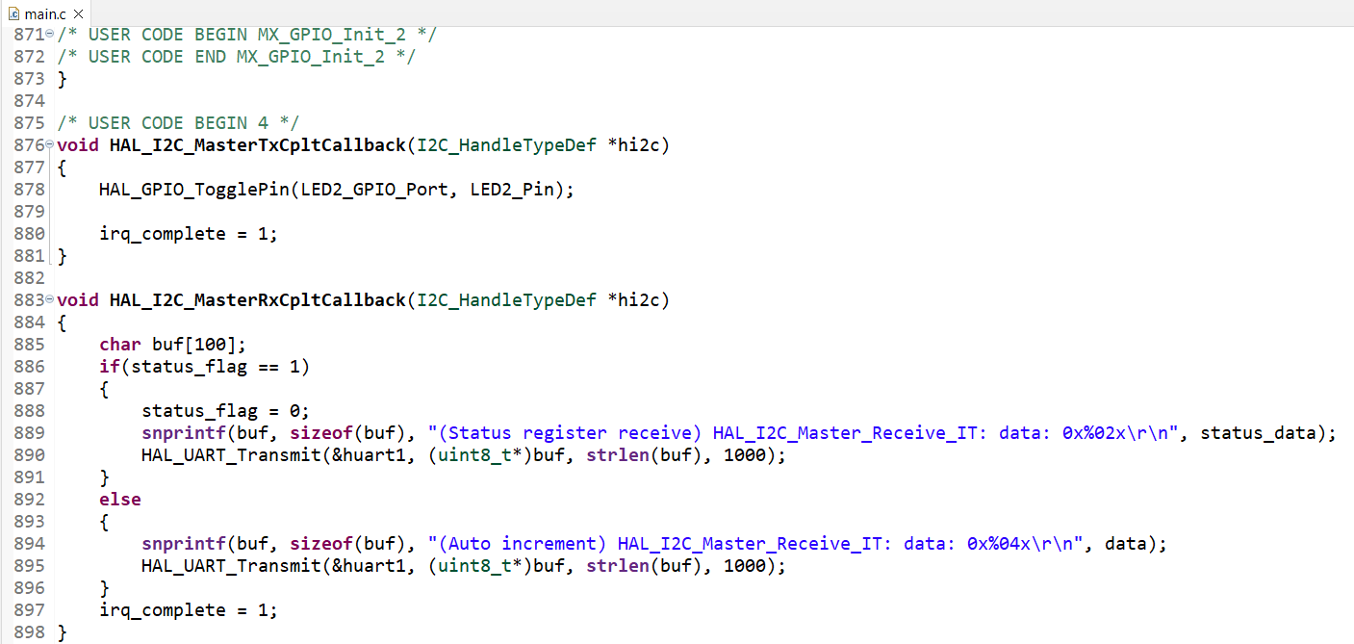
Step 17. User Story 4: Tx and Rx call back function implementation

Slide 19
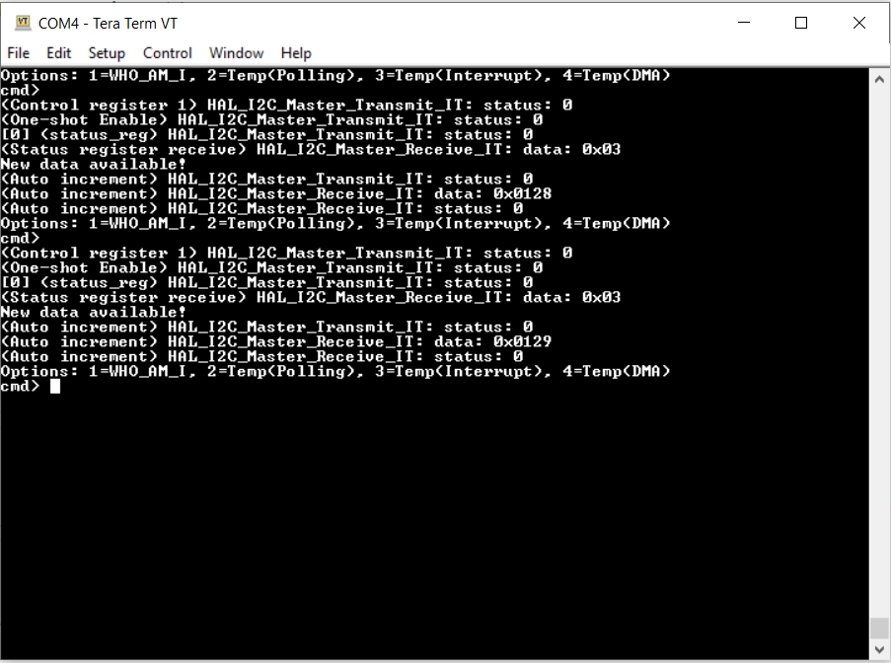
Step 18. User Story 4: Build and run the code, test is successful. I use auto increment to read the temperature data

Slide 20
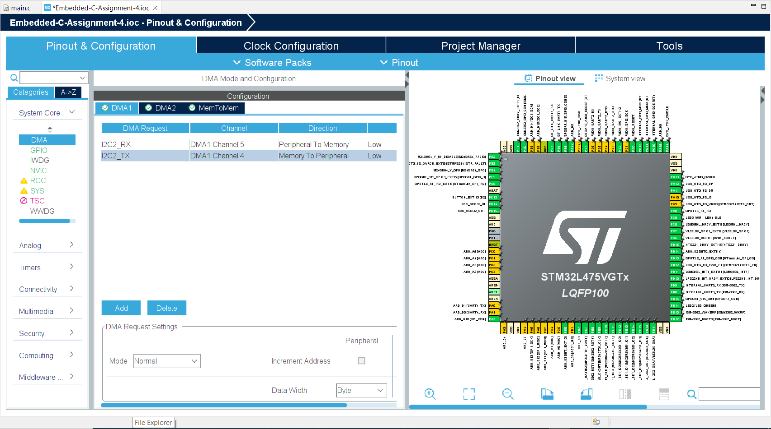
Step 19. User Story 5. Temperature. DMA. When the user selects 4, use DMA to read from HTS221 and display temperature on console. Modify the DMA1 in .ioc file first

Slide 21
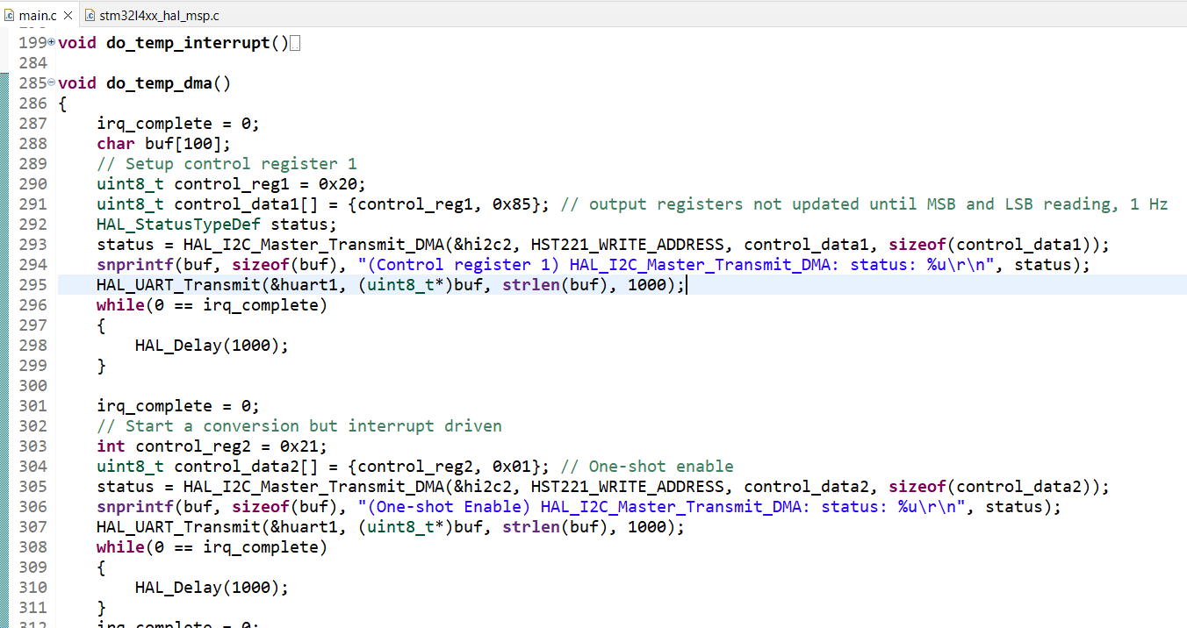
Step 20. User Story 5. Write the code in main.c file, it is very similar to the interrupt version

Slide 22
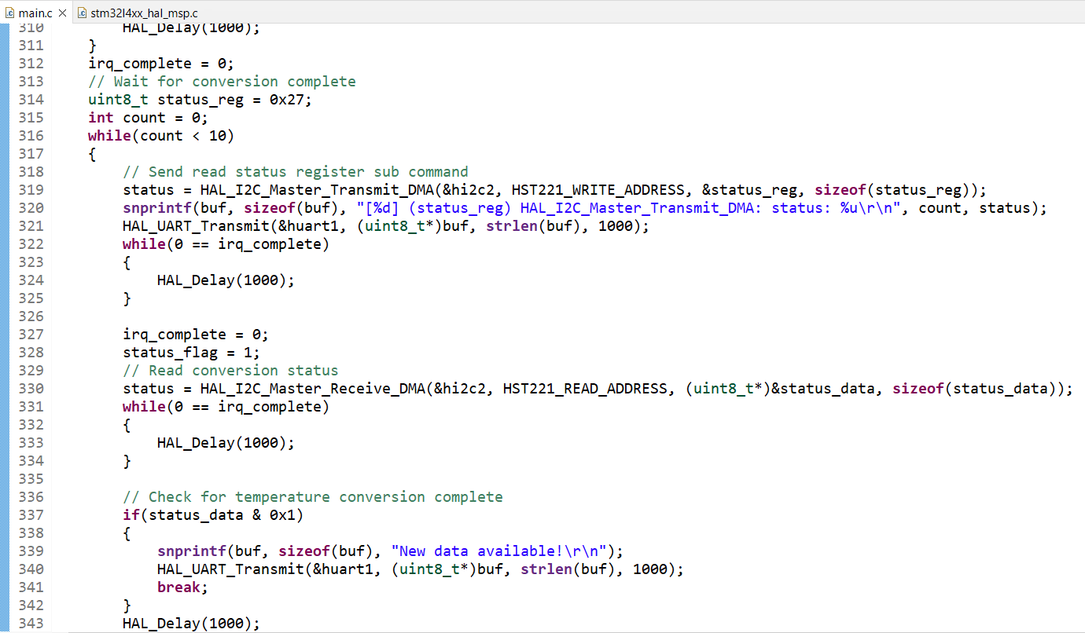
Step 21. User Story 5. Write the code in main.c file, continue

Slide 23
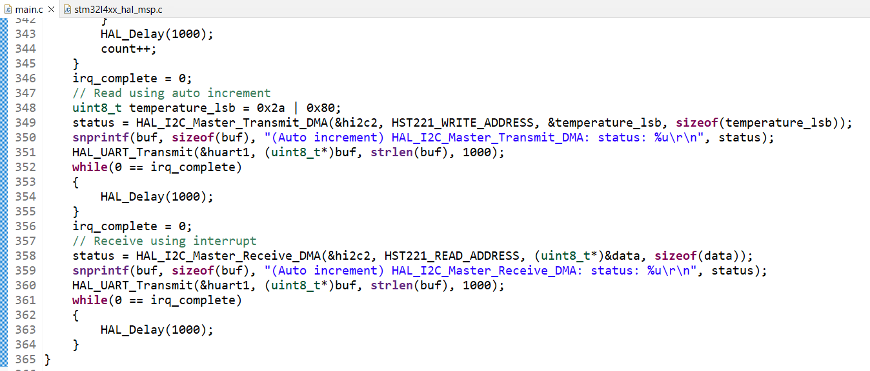
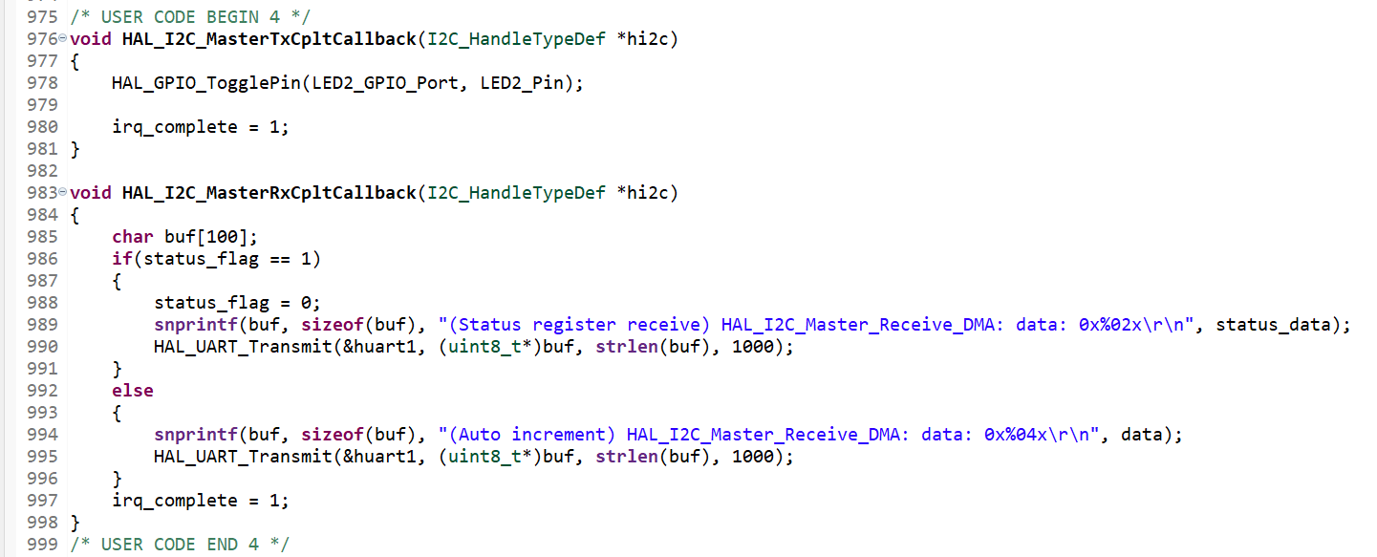
Step 22. User Story 5. Write the code in main.c file, continue

Slide 24
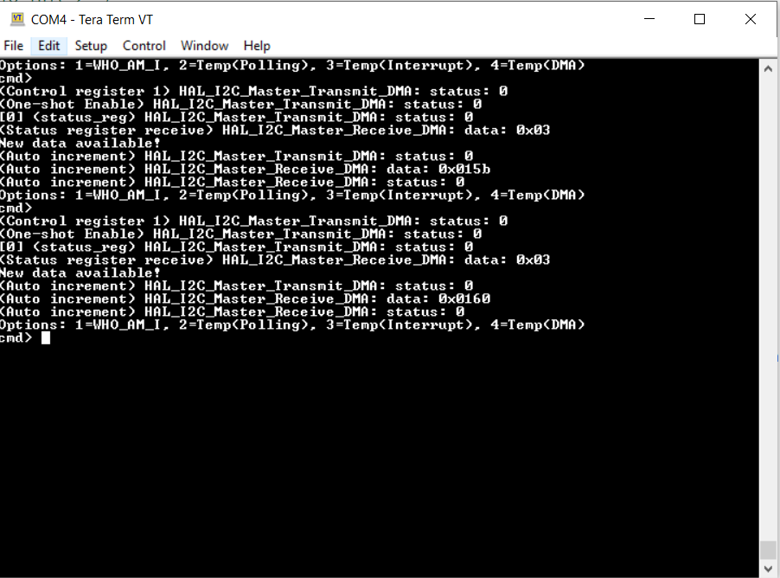
Step 23. User Story 5. Build and run the code, test is successful

Slide 25
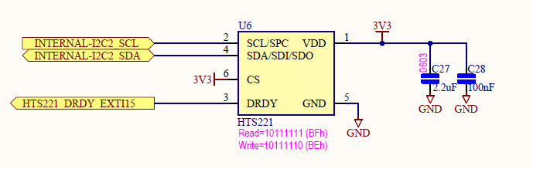
Appendix, schematic for HTS221

